Slide 1
Mastering Enterprise JavaBeans
Anmol Arora, 19th November 2020

Slide 2
Contents
Introduction
Part One Overview
Overview
The Motivation for EJB
Divide and Conquer to the Extreme
Component Architectures
Introducing Enterprise JavaBeans
Why Java
EJB as a Business Solution
The EJB Ecosystem
The Bean Provider
The Application Assembler
The EJB Deployer
The System Administrator
The Container and Server Provider
The Tool Vendors
Summary of Roles

Slide 3
The Java 2 Platform, Enterprise Edition (J2EE)
The J2EE Technologies
Summary
EJB Fundamentals
Enterprise Beans
Types of Beans
Distributed Objects: The Foundation for EJB
Distributed Objects and Middleware
Explicit Middleware
Implicit Middleware
What Constitutes an Enterprise Bean?
The Enterprise Bean Class
The EJB Object
The Home Object
The Local Interfaces
Deployment Descriptors
Vendor-Specific Files
Ejb-Jar File
Summary of Terms
Summary

Slide 4
Writing Your First Bean
How to Develop an EJB Component
The Remote Interface
The Local Interface
The Home Interface
The Local Home Interface
The Bean Class
The Deployment Descriptor
The Vendor-Specific Files
The Ejb-jar File
Deploying the Bean
The Optional EJB Client JAR file
Understanding How to Call Beans
Looking up a Home Object
Running the System
The Server-Side Output
The Client-Side Output
Implementing Component Interfaces
A Solution
Summary

Slide 5
Part Two The Triad of Beans
Introduction to Session Beans
Session Bean Lifetime
Session Bean Subtypes
Stateful Session Beans
Stateless Session Beans
Special Characteristics of Stateful Session Beans
Achieving the Effect of Pooling with Stateful Beans
The Rules Governing Conversational State
Activation and Passivation Callbacks
Method Implementation Summary
A Simple Stateful Session Bean
Life Cycle Diagrams for Session Beans
Summary

Slide 6
Introduction to Entity Beans
Persistence Concepts
Java Object Serialization
Object-Relational Mapping
Object Databases
What Is an Entity Bean?
About the Files that Make up an Entity Bean
Features of Entity Beans
Entity Beans Survive Failures
Entity Bean Instances Are a View into a Database
Several Entity Bean Instances May Represent the Same Underlying Data
Entity Bean Instances Can Be Pooled
There Are Two Ways to Persist Entity Beans
Creation and Removal of Entity Beans
Entity Beans Can Be Found
You Can Modify Entity Bean Data without Using EJB
Entity Contexts
getEJBLocalObject() / getEJBObject()
getPrimaryKey()
Summary

Slide 7
Writing Bean-Managed Persistent Entity Beans
Entity Bean Coding Basics
Finding Existing Entity Beans: ejbFind()
Bean-Managed Persistence Example: A Bank Account
Account.java
AccountLocal.java
AccountHome.java
AccountLocalHome.java
AccountPK.java
AccountBean.java
AccountException.java
Client.java
The Deployment Descriptor
The Container-Specific Deployment Descriptor
Setting up the Database
Running the Client Program
Server-Side Output
Client-Side Output
Putting It All Together: Walking through a BMP Entity Bean’s Life Cycle
Summary

Slide 8
Writing Container-Managed Persistent Entity Beans
Features of CMP Entity Beans
CMP Entity Beans Are Subclassed
CMP Entity Beans Have No Declared Fields
CMP Get/Set Methods Are Defined in the Subclass
CMP Entity Beans Have an Abstract Persistence Schema
CMP Entity Beans Have a Query Language
CMP Entity Beans Can Have ejbSelect() Methods
Implementation Guidelines for Container-Managed Persistence
Container-Managed Persistence Example: A Product Line
Product.java
ProductLocal.java
ProductHome.java
ProductLocalHome.java
ProductPK.java
ProductBean.java
The Deployment Descriptor
The Container-Specific Deployment Descriptor
Client.java
Running the Client Program
The Life Cycle of a CMP Entity Bean
Summary

Slide 9
Introduction to Message-Driven Beans
Motivation to Use Message-Driven Beans
The Java Message Service (JMS)
Messaging Domains
The JMS API
Integrating JMS with EJB
What Is a Message-Driven Bean?
Developing Message-Driven Beans
The Semantics
A Simple Example
Advanced Concepts
Message-Driven Bean Gotchas
Message Ordering
Missed ejbRemove() Calls
Poison Messages
How to Return Results Back to Message Producers
The Future: Asynchronous Method Invocations
Summary

Slide 10
Adding Functionality to Your Beans
Calling Beans from Other Beans
Default JNDI Lookups
Understanding EJB References
Resource Factories
Environment Properties
Understanding EJB Security
Security Step 1: Authentication
Security Step 2: Authorization
Security Propagation
Understanding Handles
Home Handles
Summary

Slide 11
Part Three Advanced Enterprise JavaBeans Concepts
Transactions
Motivation for Transactions
Atomic Operations
Network or Machine Failure
Multiple Users Sharing Data
Benefits of Transactions
The ACID Properties
Transactional Models
Flat Transactions
Nested Transactions
Other Transactional Models
Enlisting in Transactions with Enterprise JavaBeans
Underlying Transaction System Abstraction
Declarative, Programmatic, and Client-Initiated Transactions
Choosing a Transaction Style
Container-Managed Transactions
EJB Transaction Attribute Values
Programmatic Transactions in EJB
CORBA’s Object Transaction Service (OTS)
The Java Transaction Service (JTS)
The Java Transaction API (JTA)
Declarative versus Programmatic Transactions Example
Transactions from Client Code
Transactional Isolation
The Need for Concurrency Control
Isolation and EJB
The Dirty Read Problem
The Unrepeatable Read Problem
The Phantom Problem
Transaction Isolation Summary
Isolation and EJB
Pessimistic and Optimistic Concurrency Control
Distributed Transactions
Durability and the Two-Phase Commit Protocol
The Transactional Communications Protocol and Transaction Contexts
Designing Transactional Conversations in EJB
Summary

Slide 12
BMP and CMP Relationships
The CMP and BMP Difference
Cardinality
1:1 Relationships
1:N Relationships
M:N Relationships
Directionality
Implementing Directionality with BMP
Implementing Directionality with CMP
Directionality May Not Map to Database Schemas
Bidirectional or Unidirectional?
Lazy Loading
Aggregation vs. Composition and Cascading Deletes
Relationships and EJB-QL
Recursive Relationships
Circular Relationships
Referential Integrity
Relationships, Referential Integrity, and Client Code
Summary

Slide 13
Persistence Best Practices
When to Use Entity Beans
Control 362 Parameter Passing Analogy
Procedural Versus Object-Oriented
Caching
Enforcement of Schema Independence
Ease of Use
Migration
Rapid Application Development
Choosing between CMP and BMP
Code Reduction and Rapid Application Development
Performance
Bugs
Control
Application Server and Database Independence
Relationships
Learning Curve and Cost
Choosing the Right Granularity for Entity Beans
Persistence Tips and Tricks
Beware the Object-Relational Impedance Mismatch
Hard-Coded Versus Soft-Coded SQL
When to Use Stored Procedures
Normalizing and Denormalizing
Use Your EJB Object Model to Drive Your Data Model
Follow a Good Data Design Process
Use Surrogate Keys
Understand the Impacts of Database Updates
Versioning EJB Components
Living with a Legacy Database Design
Handling Large Result Sets
Summary

Slide 14
EJB Best Practices and Performance Optimizations
When to Use Stateful versus Stateless
When to Use Messaging versus RMI-IIOP
How to Guarantee a Response Time with Capacity Planning
How to Achieve Singletons with EJB
Wrap Entity Beans with Session Beans
Performance-Tuning Entity Beans
Choosing between Local Interfaces and Remote Interfaces
How to Debug EJB Issues
Partitioning Your Resources
Assembling Components
Developing Components to Be Reusable
When to Use XML in an EJB System
Legacy Integration with EJB
Summary

Slide 15
Clustering
Overview of Large-Scale Systems
What Is a Large-Scale System?
Basic Terminology
Partitioning Your Clusters
Instrumenting Clustered EJBs
How EJBs Can Be Clustered
The Concept of Idempotence
Stateless Session Bean Clustering
Stateful Session Bean Clustering
Entity Bean Clustering
Message-Driven Bean Clustering
Other EJB Clustering Issues
First Contact
Initial Access Logic
Summary

Slide 16
Starting Your EJB Project on the Right Foot
Get the Business Requirements Down
Decide Whether J2EE is Appropriate
Decide Whether EJB Is Appropriate
Staff Your Project
Design Your Complete Object Model
Implement a Single Vertical Slice
Choose an Application Server
Divide Your Team
Invest in Tools
Invest in a Standard Build Process
Next Steps
Summary

Slide 17
Choosing an EJB Server
J2EE 1.3 Brand
Pluggable JRE
Conversion Tools
Complex Mappings
Third-Party JDBC Driver Support
Lazy-Loading
Deferred Database Writes
Pluggable Persistence Providers
In-Memory Data Cache
Integrated Tier Support
Scalability
High Availability
Security
IDE Integration
UML Editor Integration
Intelligent Load Balancing
Stateless Transparent Fail-over
Clustering
Java Management Extension (JMX)
Administrative Support
Hot Deployment
Instance Pooling
Automatic EJB Generation
Clean Shutdown
Real-Time Deployment
Distributed Transactions
Superior Messaging Architecture
Provided EJB Components
J2EE Connector Architecture (JCA)
Web Services
Workflow
Open Source
Specialized Services
Nontechnical Criteria
Summary

Slide 18
EJB-J2EE Integration: Building a Complete Application
The Business Problem
A Preview of the Final Web Site
Scoping the Technical Requirements
Object Model for the Business Logic Tier
Object Model for the Presentation Tier
Example Code
Summary

Slide 19
RMI-IIOP and JNDI Tutorial
Java RMI-IIOP
Remote Method Invocations
The Remote Interface
The Remote Object Implementation
Stubs and Skeletons
Object Serialization and Parameter Passing
Passing By-Value
Object Serialization
What Should You Make Transient?
Object Serialization and RMI-IIOP
The Java Naming and Directory Interface (JNDI)
Naming and Directory Services
Problems with Naming and Directories
Enter JNDI
Benefits of JNDI
JNDI Architecture
JNDI Concepts
Programming with JNDI
Integrating RMI-IIOP and JNDI
Binding an RMI-IIOP Server to JNDI
Looking up an RMI-IIOP Server with JNDI
Summary

Slide 20
CORBA Interoperability
What Is CORBA?
CORBA as the Basis for EJB
Why Should I Care about CORBA?
Drawbacks of CORBA
Understanding How CORBA Works
Object Request Brokers
OMG’s Interface Definition Language
OMG IDL Maps to Concrete Languages
CORBA Static Invocations
CORBA’s Many Services
The Need for RMI-IIOP
The Need for RMI-CORBA Interoperability
Combining RMI with CORBA
Steps to Take for RMI and CORBA to Work Together: An Overview
RMI-IIOP Client with a CORBA Object Implementation
CORBA Client with an RMI-IIOP Object Implementation
Bootstrapping with RMI-IIOP and CORBA
The Big Picture: CORBA and EJB Together
Sample Code
Summary

Slide 21
Deployment Descriptor Reference
How to Read a DTD
The Header and Root Element
Defining Session Beans
<session>
Defining Entity Beans
<entity>
<cmp-field>
<query>
<query-method>
<method-params>
Defining Message-Driven Beans
<message-driven>
<message-driven-destination>
Defining Environment Properties
<env-entry>
Defining EJB References
<ejb-ref>
<ejb-local-ref>
Defining Security
<security-role-ref>
<security-identity>
<run-as>
Defining Resource Factories
<resource-ref>
<resource-env-ref>
Defining Relationships
<relationships>
<ejb-relation>
<ejb-relationship-role>
<relationship-role-source>
<cmr-field>
Defining the Assembly Descriptor
<assembly-descriptor>
<security-role>
<method-permission>
<container-transaction>
<exclude-list>
<method>
<method-params>

Slide 22
The EJB Query Language (EJB-QL)
Overview
A Simple Example
The Power of Relationships
EJB-QL Syntax
The FROM Clause
The WHERE Clause
The SELECT Clause
Truth Tables
Final Note
Summary

Slide 23
EJB Quick Reference Guide
Session Bean Diagrams
Stateless Session Bean Diagrams
Stateful Session Bean Diagrams
Entity Bean Diagrams
Message-Driven Bean Diagrams
EJB API Reference
EJBContext
EJBHome
EJBLocalHome
EJBLocalObject
EJBMetaData
EJBObject
EnterpriseBean
EntityBean
EntityContext
Handle
HomeHandle
MessageDrivenBean
MessageDrivenContext
SessionBean
SessionContext
SessionSynchronization
Exception Reference
Transaction Reference

Slide 24
From Here
Now that we’ve gotten the logistics out of the way, let’s begin our exploration of Enterprise JavaBeans with Part 1, an introduction to EJB concepts and programming.

Slide 25
Part One Overview

Slide 26
In Part 1, we introduce the server-side development platform that is the Java 2 Platform, Enterprise Edition (J2EE), of which the Enterprise JavaBeans (EJB) component architecture is a vital piece. J2EE is a conglomeration of concepts, programming standards, and innovations—all written in the Java programming language. With J2EE, you can rapidly construct distributed, scalable, reliable, and portable secure server-side deployments.

Slide 27
Overview

Slide 28
Enterprise JavaBeans (EJB) is a server-side component architecture that simplifies the process of building enterprise-class distributed component applications in Java. By using EJB, you can write scalable, reliable, and secure applications without writing your own complex distributed component framework. EJB is about rapid application development for the server side; you can quickly and easily construct server-side components in Java by leveraging a prewritten distributed infrastructure provided by the industry. EJB is designed to support application portability and reusability across any vendor’s enterprise middleware services.

Slide 29
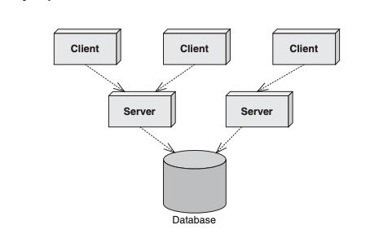
The Motivation for EJB
Figure shows a typical business application. This application could exist in any vertical industry and could solve any business problem. Here are some examples:
■■ A stock trading system
■■ A banking application
■■ A customer call centre
■■ A procurement system
■■ An insurance risk analysis application
Standard multi-tier deployment

Slide 30
The Motivation for EJB
Notice that this application is a distributed system. We broke up what would normally be a large, monolithic application and divorced each layer of the application from the others, so that each layer is completely independent and distinct.
Take a look at this picture, and ask yourself the following question based purely on your personal experience and intuition: If we take a monolithic application and break it up into a distributed system with multiple clients connecting to multiple servers and databases over a network, what do we need to worry about now (as shown in Figure)?

Slide 31
The Motivation for EJB
The application server was born to let you buy these middleware services, rather than build them yourself. Application servers provide you with common middleware services, such as resource pooling, networking, and more. Application servers allow you to focus on your application and not worry about the middleware you need for a robust server-side deployment. You write the code specific to your vertical industry and deploy that code into the runtime environment of an application server. You’ve just solved your business problem by dividing and conquering.

Slide 32
Divide and Conquer to the Extreme
We’ve just discussed how you can gain your middleware from an application server, empowering you to focus on your business problem. But there’s even better news: You may be able to buy a partial solution to the business problem itself.
To achieve this, you need to build your application out of components. A component is code that implements a set of well-defined interfaces. It is a manageable, discrete chunk of logic. Components are not entire applications—they cannot run alone. Rather, they can be used as puzzle pieces to solve some larger problem.

Slide 33
Divide and Conquer to the Extreme
The idea of software components is very powerful. A company can purchase a well-defined module that solves a problem and combine it with other components to solve larger problems. For example, consider a software component that computes the price of goods. We’ll call this a pricing component. You hand the pricing component information about a set of products, and it figures out the total price of the order.

Slide 34
Divide and Conquer to the Extreme
The pricing problem can get quite hairy. For example, let’s assume we’re ordering computer parts, such as memory and hard drives. The pricing component figures out the correct price based on a set of pricing rules that may include:
Base prices of a single memory upgrade or a single hard disk
Quantity discounts that a customer receives for ordering more than 10 memory modules
Bundling discounts that the customer receives for ordering both memory and a hard disk
Preferred customer discounts that you can give to big-name customers
Locale discounts depending on where the customer lives
Overhead costs such as shipping and taxes

Slide 35
Divide and Conquer to the Extreme
These pricing rules are in no way unique to ordering computer parts. Other industries, such as health care, appliances, airline tickets, and others need the same pricing functionality. Obviously, it would be a huge waste of resources if each company that needed complex pricing had to write its own sophisticated pricing engine. Thus, it makes sense that a vendor provides a generic pricing component that can be reused for different customers. For example:

Slide 36
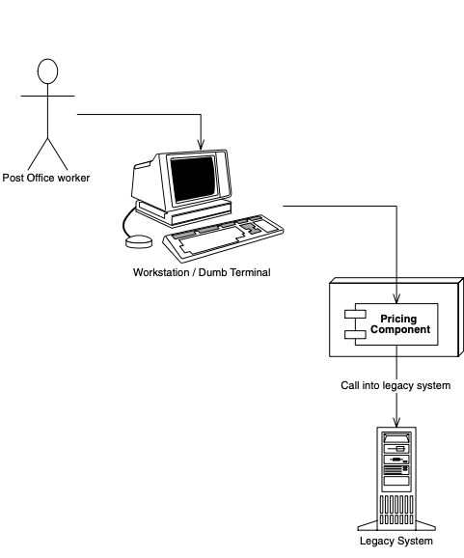
Divide and Conquer to the Extreme
The U.S. Postal Service can use the pricing component to compute shipping costs for mailing packages. This is shown in Figure.
Reusing a pricing component for the U.S. Postal Service

Slide 37
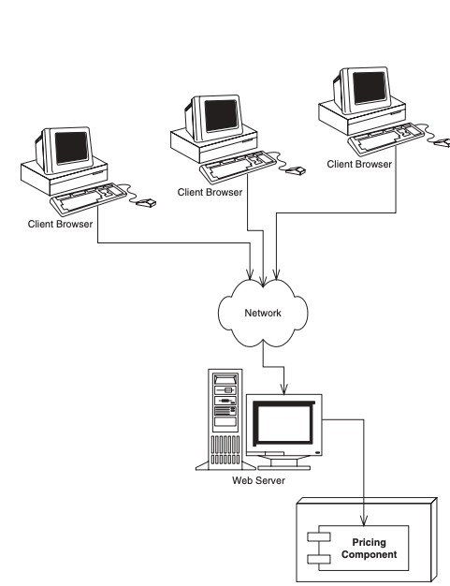
Divide and Conquer to the Extreme
An automobile manufacturer can use the pricing component to determine prices for cars. This manufacturer may set up a Web site that allows customers to get price quotes for cars over the Internet. Figure illustrates this scenario.
Reusing a pricing component for quoting car prices over the Internet

Slide 38
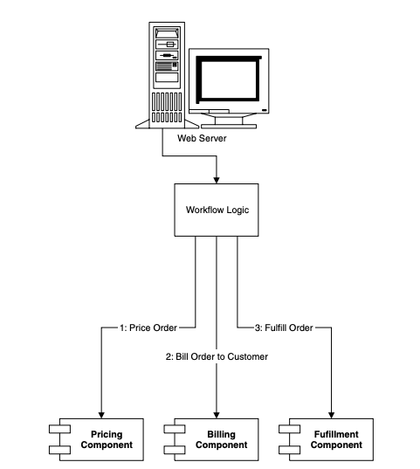
Divide and Conquer to the Extreme
An online grocery store can use the pricing component as one discrete part of a complete workflow solution. When a customer purchases groceries over the Web, the pricing component first computes the price of the groceries. Next, a different vendor’s component bills the customer with the generated price. Finally, a third component fulfills the order, setting things in motion for the groceries to be delivered to the end user. We depict this in Figure.
Reusing a pricing component as part of an e-commerce workflow solution

Slide 39
Divide and Conquer to the Extreme
Reusable components are quite enticing because components promote rapid application development. An IT shop can quickly assemble an application from prewritten components rather than writing the entire application from scratch. This means:
The IT shop needs less in-house expertise. The IT shop can consider the pricing component to be a black box, and it does not need experts in complex pricing algorithms.
The application is assembled faster. The component vendor has already written the tough logic, and the IT shop can leverage that work, saving development time.

Slide 40
Divide and Conquer to the Extreme
There is a lower total cost of ownership. The component vendor’s cash cow is its components, and therefore it must provide top-notch documentation, support, and maintenance if it is to stay in business. Because the component vendor is an expert in its field, the component generally has fewer bugs and higher performance than an IT shop’s home-grown solution. This reduces the IT shop’s maintenance costs.
Once the rules of engagement have been laid down for how components should be written, a component marketplace is born, where vendors can sell reusable components to companies. The components are deployed within application servers, which provide the needed middleware.

Slide 41
Divide and Conquer to the Extreme
Things to Consider When Building Large Business Systems
By now you should have a decent list of things you’d have to worry about when building large business systems. Here’s a short list of the big things we came up with. Don’t worry if you don’t understand all of them yet—you will.
■■ Remote method invocations. We need logic that connects a client and server via a network connection. This includes dispatching method requests, brokering of parameters, and more.
■■ Load balancing. Clients must be directed to the server with the lightest load. If a server is overloaded, a different server should be chosen.
■■ Transparent fail-over. If a server crashes, or if the network crashes, can clients be rerouted to other servers without interruption of service? If so, how fast does fail-over happen? Seconds? Minutes? What is acceptable for your business problem?
■■ Back-end integration. Code needs to be written to persist business data into databases as well as integrate with legacy systems that may already exist.
■■ Transactions. What if two clients access the same row of the database simultaneously? Or what if the database crashes? Transactions protect you from these issues.
■■ Clustering. What if the server contains state when it crashes? Is that state replicated across all servers, so that clients can use a different server?
■■ Dynamic redeployment. How do you perform software upgrades while the site is running? Do you need to take a machine down, or can you keep it running?
■■ Clean shutdown. If you need to shut down a server, can you do it in a smooth, clean manner so that you don’t interrupt service to clients who are currently using the server?
■■ Logging and auditing. If something goes wrong, is there a log that we can consult to determine the cause of the problem? A log would help us debug the problem so it doesn’t happen again.

Slide 42
Divide and Conquer to the Extreme
Things to Consider When Building Large Business Systems
■■ Systems Management. In the event of a catastrophic failure, who is monitoring our system? We would like monitoring software that paged a system administrator if a catastrophe occurred.
■■ Threading. Now that we have many clients connecting to a server, that server is going to need the capability of processing multiple client requests simultaneously. This means the server must be coded to be multi-threaded.
■■ Message-oriented middleware. Certain types of requests should be message-based where the clients and servers are very loosely coupled. We need infrastructure to accommodate messaging.
■■ Object life cycle. The objects that live within the server need to be created or destroyed when client traffic increases or decreases, respectively
■■ Resource pooling. If a client is not currently using a server, that server’s precious resources can be returned to a pool to be reused when other clients connect. This includes sockets (such as database connections) as well as objects that live within the server.
■■ Security. The servers and databases need to be shielded from saboteurs. Known users must be allowed to perform only operations that they have rights to perform.
■■ Caching. Let’s assume there is some database data that all clients share and make use of, such as a common product catalog. Why should your servers retrieve that same catalog data from the database over and over again? You could keep that data around in the servers’ memory and avoid costly network roundtrips and database hits.
■■ And much, much, much more.
Each of these issues is a separate service that needs to be addressed for serious server-side computing. These services are needed in any business problem and in any vertical industry. And each of these services requires a lot of thought and a lot of plumbing to resolve. Together, these services are called middleware.

Slide 43
Divide and Conquer to the Extreme
Is a Component Marketplace a Myth?
There is a very small component marketplace today. For years we’ve been hoping that the marketplace will explode, but it is behind schedule. There are several reasons for Independent Software Vendors (ISVs) not shipping components:
Maturity. Because components live inside application servers, the application servers must be mature before we see components written to those servers.
Politics. Many ISVs have written their own application servers. Some (falsely) view this as a competitive advantage.
Questionable value. Most ISVs are customer-driven (meaning they prioritize what their customers are asking for). Since components are new to many customers, many of them are not asking for their ISVs to support components.

Slide 44
Component Architectures
It has been a number of years since the idea of multi-tier server-side deployments surfaced. Since then, well over 50 application servers have appeared on the market. At first, each application server provided component services in a nonstandard, proprietary way. This occurred because there was no agreed definition of what a component should be. The result? Once you bet on an application server, your code was locked into that vendor’s solution. This greatly reduced portability and was an especially tough pill to swallow in the Java world, which promotes openness and portability. It also hampered the commerce of components, because a customer could not combine a component written to one application server with another component written to a different application server.

Slide 45
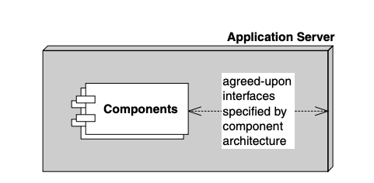
Component Architectures
What we need is an agreement, or set of interfaces, between application servers and components. This agreement will enable any component to run within any application server. This will allow components to be switched in and out of various application servers without having to change code or potentially even recompile the components themselves. Such an agreement is called component architecture and is shown in Figure.
A component architecture

Slide 46
Component Architectures
If you’re trying to explain components to a non-techie, try these analogies:
■■ Any CD player can play any compact disc because of the CD standard. Think of an application server as a CD player and components as compact discs.
■■ In the United States, any TV set can tune into any broadcast because of the NTSC standard. Think of an application server as a TV set and components as television broadcasts.

Slide 47
Introducing Enterprise JavaBeans
The Enterprise JavaBeans (EJB) standard is a component architecture for deployable server-side components in Java. It is an agreement between components and application servers that enable any component to run in any application server. EJB components (called enterprise beans) are deployable, and can be imported and loaded into an application server, which hosts those components.
The top three values of EJB are as follows:
It is agreed upon by the industry. Those who use EJB will benefit from its widespread use. Because everyone will be on the same page, in the future it will be easier to hire employees who understand your systems (since they may have prior EJB experience), learn best practices to improve your system (by reading books), partner with businesses (since technology will be compatible), and sell software (since customers will accept your solution). The concept of “train once, code anywhere” applies.

Slide 48
Introducing Enterprise JavaBeans
Portability is easier. The EJB specification is published and available freely to all. Since EJB is a standard, you do not need to gamble on a single, proprietary vendor’s architecture. And although portability will never be free, it is cheaper than without a standard.
Rapid application development. Your application can be constructed faster because you get middleware from the application server. There’s also less of a mess to maintain.

Slide 49
Introducing Enterprise JavaBeans
Physically, EJB is actually two things in one:
A specification. This is a 500-plus-page Adobe Acrobat PDF file, freely downloadable from http://java.sun.com. This specification lays out the rules of engagement between components and application servers. It constricts how you program so that you can interoperate.
A set of Java interfaces. Components and application servers must conform to these interfaces. Since all components are written to the same interfaces, they all look the same to the application server. The application server therefore can manage anyone’s components. You can freely download these interfaces from http://java.sun.com.

Slide 50
Introducing Enterprise JavaBeans
Why Java?
EJB components must be written in Java only and require dedication to Java. This is indeed a serious restriction. The good news, however, is that Java is an ideal language to build components, for many reasons.
Interface/implementation separation. We need a clean interface/implementation separation to ship components. After all, customers who purchase components shouldn’t be messing with implementation. Upgrades and support will become horrendous. Java supports this at a syntactic level via the interface keyword and class keyword.

Slide 51
Introducing Enterprise JavaBeans
Why Java?
Safe and secure. The Java architecture is much safer than traditional programming languages. In Java, if a thread dies, the application stays up. Pointers are no longer an issue. Memory leaks occur much less often. Java also has a rich library set, so that Java is not just the syntax of a language but a whole set of prewritten, debugged libraries that enable developers to avoid reinventing the wheel in a buggy way. This safety is extremely important for mission-critical applications. Sure, the overhead required to achieve this level of safety might make your application slower, but 90 percent of all business programs are glorified Graphical User Interfaces (GUIs) to databases. That database is going to be your number one bottleneck, not Java.
Cross-platform. Java runs on any platform. Since EJB is an application of Java, this means EJB should also easily run on any platform. This is valuable for customers who have invested in a variety of powerful hardware, such as Win32, UNIX, and mainframes. They do not want to throw away these investments.

Slide 52
Introducing Enterprise JavaBeans
Why Java?
If you don’t want to go the EJB route, you have two other choices as well:
■■ Microsoft’s .NET managed components, part of the Microsoft.NET platform
■■ The Object Management Group (OMG’s) Common Object Request Broker Architecture (CORBA)
Note that many EJB servers are based upon and can interoperate with CORBA.

Slide 53
Introducing Enterprise JavaBeans
EJB as a Business Solution
EJB is specifically used to help solve business problems. EJB components (enterprise beans) might perform any of the following tasks.
Perform business logic. Examples include computing the taxes on the shopping cart, ensuring that the manager has authority to approve the purchase order, or sending an order confirmation email using the JavaMail API.
Access a database. Examples include submitting an order for books, transferring money between two bank accounts, or calling a stored procedure to retrieve a trouble ticket in a customer support system. Enterprise beans achieve database access using the Java Database Connectivity (JDBC) API.
Access another system. Examples include calling a high-performing CICS legacy system written in COBOL that computes the risk factor for a new insurance account, calling a legacy VSAM data store, or calling SAP R/3. Enterprise beans achieve existing application integration via the Java Connector Architecture (JCA).

Slide 54
Introducing Enterprise JavaBeans
EJB as a Business Solution
EJB components are not GUI components; rather, enterprise beans sit behind the GUIs and do all the hard work. Examples of GUIs that can connect to enterprise beans include the following:
Thick clients. Thick clients execute on a user’s desktop. They could connect via the network with EJB components that live on a server. These EJB components may perform any of the tasks listed above (business logic, database logic, or accessing other systems). Thick clients in Java include applets and applications.
Dynamically generated web pages. Web sites that are complex need their Web pages generated specifically for each request. For example, the homepage for Amazon.com is completely different for each user, depending on the user’s profile. Java servlets and JavaServer Pages (JSPs) are used to generate such specific pages. Both servlets and JSPs live within a Web server and can connect to EJB components, generating pages differently based upon the values returned from the EJB layer.

Slide 55
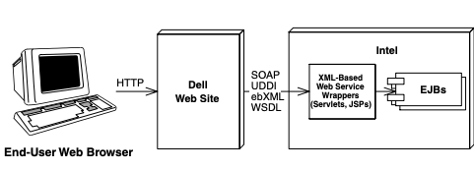
Introducing Enterprise JavaBeans
EJB as a Business Solution
XML-based Web Service wrappers. Some business applications require no user interface at all. They exist to interconnect with other business partners’ applications that may provide their own user interface. For example, Dell Computer Corporation needs to purchase Intel chips to manufacture desktop computers. Intel could expose a Web Service that enables Dell’s software to connect and order chips. In this case, Intel’s system does not have a user interface of its own, but rather acts as a Web Service. Possible technologies used here include SOAP, UDDI, ebXML, and WSDL. This is shown in Figure.
EJBs as the back-end to Web services

Slide 56
Introducing Enterprise JavaBeans
EJB as a Business Solution
The real difference between GUI components (thick clients, dynamically generated Web pages, and Web Service wrappers) and enterprise beans is the domain that each component type is intended to be part of. GUI components are well suited to handle client-side operations, such as rendering GUIs (although they don’t necessarily need to have one), performing other presentation-related logic, and lightweight business logic operations. They deal directly with the end-user or business partner.
Enterprise beans, on the other hand, are not intended for the client side; they are server-side components. They are meant to perform server-side operations, such as executing complex algorithms or performing high-volume business transactions. The server side has different kinds of needs from a rich GUI environment. Server-side components need to run in a highly available (24 X 7), fault-tolerant, transactional, and multiuser secure environment. The application server provides this high-end server-side environment for the enterprise beans, and it provides the runtime containment necessary to manage enterprise beans.

Slide 57
The EJB Ecosystem
To get an EJB deployment up and running successfully, you need more than just an application server and components. In fact, EJB encourages collaboration of more than six different parties. Each of these parties is an expert in its own field and is responsible for a key part of a successful EJB deployment. Because each party is a specialist, the total time required to build an enterprise-class deployment is significantly reduced. Together, these players form the EJB Ecosystem.
The EJB Ecosystem is not for everyone. At my company, we’ve heard ghastly stories of businesses choosing EJB because everyone else is using it, or because it is new and exciting. Those are the wrong reasons to use EJB and can result in disappointing results.

Slide 58
The EJB Ecosystem
JavaBeans. Enterprise JavaBeans
You may have heard of another standard called JavaBeans. JavaBeans are completely different from Enterprise JavaBeans.
JavaBeans are much smaller than Enterprise JavaBeans. You can use JavaBeans to assemble larger components or to build entire applications. JavaBeans, however, are development components and are not deployable components. You typically do not deploy a JavaBean; rather, JavaBeans help you construct larger software that is deployable. And because they cannot be deployed, JavaBeans do not need to live in a runtime environment. Since JavaBeans are just Java classes, they do not need an application server to instantiate them, to destroy them, and to provide other services to them. The application itself is made up of JavaBeans.

Slide 59
The EJB Ecosystem
The Bean Provider
The bean provider supplies business components, or enterprise beans. Enterprise beans are not complete applications, but rather are deployable components that can be assembled into complete solutions. The bean provider could be an ISV selling components or an internal department providing components to other departments.

Slide 60
The EJB Ecosystem
The Application Assembler
The application assembler is the overall application architect. This party is responsible for understanding how various components fit together and writes the applications that combine components. An application assembler may even author a few components along the way. His or her job is to build an application from those components that can be deployed in a number of settings. The application assembler is the consumer of the beans supplied by the bean provider.

Slide 61
The EJB Ecosystem
The Application Assembler
The application assembler could perform any or all of the following tasks:
■■ From knowledge of the business problem, decide which combination of existing components and new enterprise beans are needed to provide an effective solution; in essence, plan the application assembly.
■■ Supply a user interface (perhaps Swing, servlet/JSP, application/applet, or Web Service wrapper).
■■ Write new enterprise beans to solve some problems specific to your business problem.
■■ Write the code that calls on components supplied by bean providers.
■■ Write integration code that maps data between components supplied by different bean providers. After all, components won’t magically work together to solve a business problem, especially if different vendors write the components.

Slide 62
The EJB Ecosystem
The EJB Deployer
After the application assembler builds the application, the application must be deployed (and go live) in a running operational environment. Some challenges faced here include the following:
■■ Securing the deployment with a firewall and other protective measures
■■ Integrating with an LDAP server for security lists, such as Lotus Notes or Microsoft Active Directory
■■ Choosing hardware that provides the required level of performance
■■ Providing redundant hardware and other resources for reliability and fault tolerance
■■ Performance-tuning the system

Slide 63
The EJB Ecosystem
The System Administrator
Once the deployment goes live, the system administrator steps in to oversee the stability of the operational solution. The system administrator is responsible for the upkeep and monitoring of the deployed system and may make use of runtime monitoring and management tools that the EJB server provides.
For example, a sophisticated EJB server might page a system administrator if a serious error occurs that requires immediate attention. Some EJB servers achieve this by developing hooks into professional monitoring products, such as Tivoli and Computer Associates. Others are providing their own systems management by supporting the Java Management Extension (JMX).

Slide 64
The EJB Ecosystem
The Container and Server Provider
The container provider supplies an EJB container (the application server). This is the runtime environment in which beans live. The container supplies middleware services to the beans and manages them. Examples of EJB containers are BEA’s WebLogic, iPlanet’s iPlanet Application Server, IBM’s WebSphere, Oracle’s Oracle 9i, Macromedia’s JRun, Persistence’s PowerTier, Brokat’s Gemstone/J, HP’s Bluestone, IONA’s iPortal, Borland’s AppServer, and the JBoss open source code application server. The server provider is the same as the container provider. Sun has not yet differentiated these (and they may never do so). We will use the terms EJB container and EJB server interchangeably.

Slide 65
The EJB Ecosystem
Qualities of Service in EJB
Monitoring of EJB deployments is not specified in the EJB specification. It is an optional service that advanced EJB servers can provide. This means that each EJB server could provide the service differently.
At first blush you might think this hampers application portability. However, in reality this service should be provided transparently behind the scenes, and should not affect your application code. It is a quality of service that lies beneath the application level and exists at the systems level. Changing application servers should not affect your EJB code.

Slide 66
The EJB Ecosystem
The Tool Vendors
To facilitate the component development process, there should be a standardized way to build, manage, and maintain components. In the EJB Ecosystem, there are several Integrated Development Environments (IDEs) assist you in rapidly building and debugging components. Examples are Webgain’s Visual Cafe, IBM’s VisualAge for Java, or Borland’s JBuilder

Slide 67
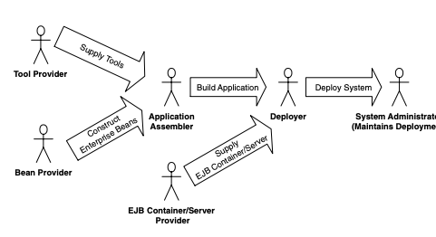
The EJB Ecosystem
Summary of Roles
Figure summarizes the interaction of the different parties in EJB.
A future EJB specification will define a new role, called the persistence manager, which plugs into an application server. Your components harness the persistence manager to map your business data into storage, such as mapping objects into relational databases.
The parties of EJB

Slide 68
The Java 2 Platform, Enterprise Edition (J2EE)
EJB is only a portion of a larger offering from Sun Microsystems called the Java 2 Platform, Enterprise Edition (J2EE). The mission of J2EE is to provide a platform-independent, portable, multiuser, secure, and standard enterpriseclass platform for server-side deployments written in the Java language.
J2EE is one of three different Java platforms. Each platform is a conceptual superset of the next smaller platform.

Slide 69
The Java 2 Platform, Enterprise Edition (J2EE)
The Java 2 Platform, Micro Edition (J2ME) is a development platform for Java-enabled devices, such as Palm Pilots, pagers, watches, and so on. This is a restricted form of the Java language due to the inherent performance and capacity limitations of small devices.
The Java 2 Platform, Standard Edition (J2SE) contains standard Java services for applets and applications, such as input/output facilities, graphical user interface facilities, and more. This platform contains what most people use in standard Java Development Kit (JDK) programming.
The Java 2 Platform, Enterprise Edition (J2EE) takes Java’s Enterprise APIs and bundles them together in a complete development platform for enterprise-class server-side deployments in Java.

Slide 70
The Java 2 Platform, Enterprise Edition (J2EE)
Specifications. Each enterprise API within J2EE has its own specification, which is a PDF file downloadable from http://java.sun.com. Each time there is a new version of J2EE, Sun locks-down the versions of each Enterprise API specification and bundles them together as the de facto versions to use when developing with J2EE. This increases code portability across vendors’ products because each vendor supports exactly the same API revision. This is analogous to a company such as Microsoft releasing a new version of Windows every few years: Every time a new version of Windows comes out, Microsoft locks-down the versions of the technologies bundled with Windows and releases them together.

Slide 71
The Java 2 Platform, Enterprise Edition (J2EE)
Test suite. Sun provides a test suite for J2EE server vendors to test their implementations against. If a server passes the tests, Sun issues a compliance brand, alerting customers that the vendor’s product is indeed J2EE-compliant. There are numerous J2EE-certified vendors, and you can read reviews of their products for free on TheServerSide.com.
Reference implementation. To enable developers to write code against J2EE as they have with the JDK, Sun provides its own free reference implementation of J2EE. Sun is positioning it as a low-end reference platform, as it is not intended for commercial use.
BluePrints Document. Each of the Enterprise APIs has a clear role in J2EE, as defined by Sun’s J2EE BluePrints document. This document is a downloadable PDF file that describes how to use the J2EE technologies together.

Slide 72
The Java 2 Platform, Enterprise Edition (J2EE)
The J2EE Technologies
The Java 2 Platform, Enterprise Edition is a robust suite of middleware services that make life very easy for server-side application developers. J2EE builds on the existing technologies in the J2SE. J2SE includes the base Java support and the various libraries (.awt, .net, .io) with support for both applets and applications. Because J2EE builds on J2SE, a J2EE-compliant product must not only implement all of J2EE, but must also implement all of J2SE. This means that building a J2EE product is an absolutely huge undertaking. This barrier to entry has resulted in significant industry consolidation in the Enterprise Java space, with a few players emerging from the pack as leaders.

Slide 73
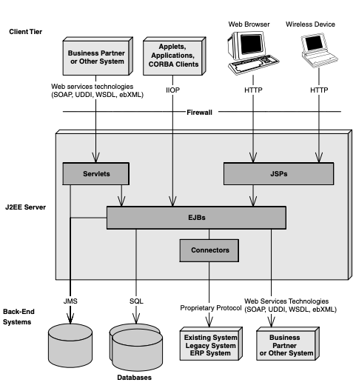
The Java 2 Platform, Enterprise Edition (J2EE)
The J2EE Technologies
We will discuss version 1.3 of J2EE, which supports EJB 2.0. Some of the major J2EE technologies are shown working together in Figure.
A Java 2 Platform, Enterprise Edition deployment

Slide 74
The Java 2 Platform, Enterprise Edition (J2EE)
The J2EE Technologies
Enterprise JavaBeans (EJB). EJB defines how server-side components are written and provides a standard contract between components and the application servers that manage them. EJB is the cornerstone for J2EE and uses several other J2EE technologies.
Java Remote Method Invocation (RMI) and RMI-IIOP. RMI is the Java language’s native way to communicate between distributed objects, such as two different objects running on different machines. RMI-IIOP is an extension of RMI that can be used for CORBA integration. RMI-IIOP is the official API that we use in J2EE (not RMI).

Slide 75
The Java 2 Platform, Enterprise Edition (J2EE)
The J2EE Technologies
Java Naming and Directory Interface (JNDI). JNDI is used to access naming and directory systems. You use JNDI from your application code for a variety of purposes, such as connecting to EJB components or other resources across the network, or accessing user data stored in a naming service such as Microsoft Exchange or Lotus Notes.
Java Database Connectivity (JDBC). JDBC is an API for accessing relational databases. The value of JDBC is that you can access any relational database using the same API.

Slide 76
The Java 2 Platform, Enterprise Edition (J2EE)
The J2EE Technologies
Java Transaction API (JTA) Java Transaction Service (JTS). The JTA and JTS specifications allow for components to be bolstered with reliable transaction support.
Java Messaging Service (JMS). JMS allows for your J2EE deployment to communicate using messaging. You can use messaging to communicate within your J2EE system as well as outside your J2EE system. For example, you can connect to existing message-oriented middleware (MOM) systems such as IBM MQSeries or Microsoft Message Queue (MSMQ). Messaging is an alternative paradigm to RMI-IIOP, and has its advantages and disadvantages.
Java Servlets. Servlets are networked components that you can use to extend the functionality of a Web server. Servlets are request/response oriented in that they take requests from some client host (such as a Web browser) and issue a response back to that host. This makes servlets ideal for performing Web tasks, such as rendering an HTML interface. Servlets differ from EJB components in that the breadth of server-side component features that EJB offers is not readily available to servlets. Servlets are much better suited to handling simple request/response needs, and they do not require sophisticated management by an application server.

Slide 77
The Java 2 Platform, Enterprise Edition (J2EE)
The J2EE Technologies
Java Pages (JSPs). JSPs are very similar to servlets. In fact, JSP scripts are compiled into servlets. The largest difference between JSP scripts and servlets is that JSP scripts are not pure Java code; they are much more centered around look-and-feel issues. You would use JSP when you want the look and feel of your deployment to be physically separate and easily maintainable from the rest of your deployment. JSPs are perfect for this, and they can be easily written and maintained by non-Java savvy staff members (JSPs do not require a Java compiler).
Java IDL. Java IDL is Sun Microsystems’ Java-based implementation of CORBA. Java IDL allows for integration with other languages. Java IDL also allows for distributed objects to leverage CORBA’s full range of services. J2EE is thus fully compatible with CORBA, completing the Java 2 Platform, Enterprise Edition.
JavaMail. The JavaMail service allows you to send email messages in a platform-independent, protocol-independent manner from your Java programs. For example, in a server-side J2EE deployment, you can use JavaMail to confirm a purchase made on your Internet e-commerce site by sending an email to the customer. Note that JavaMail depends on the JavaBeans Activation Framework (JAF), which makes JAF part of J2EE as well.

Slide 78
The Java 2 Platform, Enterprise Edition (J2EE)
The J2EE Technologies
J2EE Connector Architecture (JCA). Connectors allow you to access existing enterprise information systems from a J2EE deployment. This could include any existing system, such as a mainframe systems running high-end transactions (such as those deployed with IBM’s CICS or BEA’s TUXEDO), Enterprise Resource Planning (ERP) systems, or your own proprietary systems. Connectors are useful because they automatically manage the details of middleware navigation to existing systems, such as handling transaction and security concerns. Another value of the JCA is that you can write a driver to access an existing system once, and then deploy that driver into any J2EE-compliant server. This is important because you only need to learn how to access any given existing system once. Furthermore, the driver needs to be developed only once and can be reused in any J2EE server. This is extremely useful for independent software vendors (ISVs) who want their software to be accessible from within application servers. Rather than write a custom driver for each server, the ISV can write a single driver.

Slide 79
The Java 2 Platform, Enterprise Edition (J2EE)
The J2EE Technologies
The Java API for XML Parsing (JAXP). There are many applications of XML in a J2EE deployment. For example, you might need to parse XML if you are performing B2B interactions (such as through Web services), if you are accessing legacy systems and mapping data to and from XML, or if you are persisting XML documents to a database. JAXP is the de facto API for parsing XML documents in a J2EE deployment and is an implementation-neutral interface to XML parsers. You typically use the JAXP API from within servlets, JSPs, or EJB components. There is a free whitepaper available on TheServerSide.com that describes how to build Web services with J2EE.
The Java Authentication and Authorization Service (JAAS). JAAS is a standard API for performing security-related operations in J2EE. Conceptually, JAAS also enables you to plug in a security system to a J2EE deployment.

Slide 80
EJB Fundamentals

Slide 81
Enterprise Beans
An enterprise bean is a server-side software component that can be deployed in a distributed multi-tier environment. An enterprise bean can compose one or more Java objects because a component may be more than just a simple object. Regardless of an enterprise bean’s composition, the clients of the bean deal with a single exposed component interface. This interface, as well as the enterprise bean itself, must conform to the EJB specification. The specification requires that your beans expose a few required methods; these required methods allow the EJB container to manage beans uniformly, regardless of which container your bean is running in.

Slide 82
Enterprise Beans
As a real-world example, imagine you go to a music store to purchase a compact disc. The cashier takes your credit card and runs it through a scanner. The scanner has a small Java Virtual Machine running within it, which acts as a client of enterprise beans running on a central server. The central server enterprise beans perform the following tasks:
Contact American Express, a Web service that itself has an EJB-compliant application server containing a number of beans. The beans are responsible for conducting the credit card transaction on behalf of that client.
Call a product catalog bean, which updates inventory and subtracts the quantity the customer purchased.
Call an order entry bean, which enters the record for the customer and returns that record locator to the scanner to give to the customer on a receipt.

Slide 83
Enterprise Beans
Types of Beans
EJB 2.0 defines three different kinds of enterprise beans:
Session beans. Session beans model business processes. They are like verbs because they are actions. The action could be anything, such as adding numbers, accessing a database, calling a legacy system, or calling other enterprise beans. Examples include a pricing engine, a workflow engine, a catalog engine, a credit card authorizer, or a stock-trading engine.
Entity beans. Entity beans model business data. They are like nouns because they are data objects—that is, Java objects that cache database information. Examples include a product, an order, an employee, a credit card, or a stock. Session beans typically harness entity beans to achieve business goals, such as a stock-trading engine (session bean) that deals with stocks (entity beans). For more examples of this, see Table.

Slide 84
Enterprise Beans
Types of Beans
SESSION BEAN | ENTITY BEAN
Bank teller | Bank account
Credit card authorizer | Credit card
DNA sequencer | DNA strand
Order entry system | Order, Line item
Catalog engine | Product
Auction broker | Bid, Item
Purchase order Approval router | Purchase order
Session Beans Calling Entity Beans

Slide 85
Enterprise Beans
Types of Beans
Message-driven beans. Message-driven beans are similar to session beans in that they are actions. The difference is that you can call message-driven beans only by sending messages to those beans. Examples of message-driven beans include beans that receive stock trade messages, credit card authorization messages, or workflow messages. These message-driven beans might call other enterprise beans as well.

Slide 86
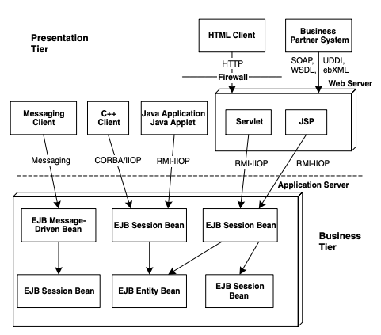
Enterprise Beans
Types of Beans
See Figure for a diagram showing some of the many possibilities of clients interacting with an EJB component system.
Clients interacting with an EJB component system

Slide 87
Distributed Objects: The Foundation for EJB
Now that you’ve seen the different types of beans, let’s dive into the technology behind them. EJB components are based on distributed objects. A distributed object is an object that is callable from a remote system. It can be called from an in-process client, an out-of-process client, or a client located elsewhere on the network.

Slide 88
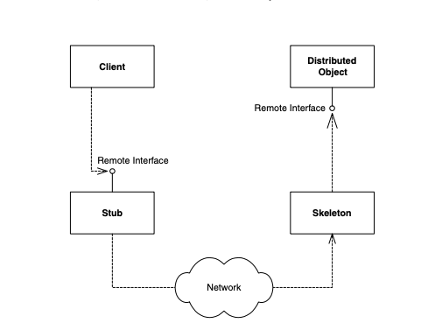
Distributed Objects: The Foundation for EJB
Figure shows how a client can call a distributed object. The following is an explanation of the diagram:
The client calls a stub, which is a client-side proxy object. This stub is responsible for masking network communications from the client. The stub knows how to call over the network using sockets, massaging parameters as necessary into their network representation.
Distributed objects

Slide 89
Distributed Objects: The Foundation for EJB
The stub calls over the network to a skeleton, which is a server-side proxy object. The skeleton masks network communication from the distributed object. The skeleton understands how to receive calls on a socket. It also knows how to massage parameters from their network representations to their Java representations.
The skeleton delegates the call to the distributed object. The distributed object does its work, and then returns control to the skeleton, which returns to the stub, which then returns control to the client.

Slide 90
Distributed Objects: The Foundation for EJB
A key point here is that both the stub and the distributed object implement the same interface (called the remote interface). This means the stub clones the distributed object’s method signatures. A client who calls a method on the stub thinks he is calling the distributed object directly; in reality, the client is calling an empty stub that knows how to go over the network. This is called local/remote transparency.

Slide 91
Distributed Objects and Middleware
Distributed objects are great because they allow you to break up an application across a network. However, as a distributed object application gets larger, you’ll need help from middleware services, such as transactions and security. There are two ways to get middleware: explicitly and implicitly. Let’s investigate both approaches.

Slide 92
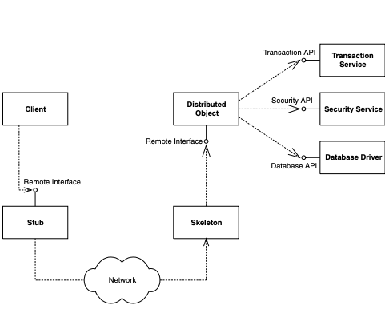
Distributed Objects and Middleware
Explicit Middleware
In traditional distributed object programming (such as traditional CORBA), you can harness middleware by purchasing that middleware off the shelf and writing code that calls that middleware API. For example, you could gain transactions by writing to a transaction API. We call this explicit middleware because you need to write to an API to gain that middleware. This is shown in Figure.
Explicit middleware (gained through APIs)

Slide 93
Distributed Objects and Middleware
Explicit Middleware
transfer(Account account1, Account account2, long amount) {
// 1: Call middleware API to perform a security check
// 2: Call middleware API to start a transaction
// 3: Call middleware API to load rows from the database
// 4: Subtract the balance from one account, add to the other
// 5: Call middleware API to store rows in the database
// 6: Call middleware API to end the transaction
}

Slide 94
Distributed Objects and Middleware
Explicit Middleware
As you can see, we are gaining middleware, but our business logic is intertwined with the logic to call these middleware APIs. The downsides to this approach are
Difficult to write. The code is bloated. We simply want to perform a transfer, but it requires a large amount of code.
Difficult to maintain. If you want to change how you do middleware, you need to rewrite your code.
Difficult to support. If you are an Independent Software Vendor (ISV) selling an application, or an internal department providing code to another department, you are unlikely to provide source code to your customers. This is because the source code is your intellectual property, and also because upgrading your customers to the next version of your software is difficult if those customers modify source code. Thus, your customers cannot change their middleware (such as changing how security works).

Slide 95
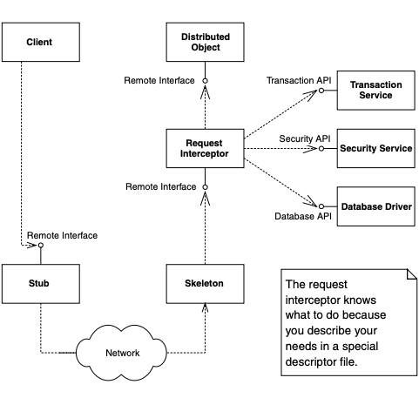
Distributed Objects and Middleware
Implicit Middleware
The crucial difference between systems of the past (transaction processing monitors such as TUXEDO or CICS, or traditional distributed object technologies such as CORBA, DCOM, or RMI) and the newer, component-based technologies (EJB, CORBA Component Model, and Microsoft.NET) is that in this new world, you can harness complex middleware in your enterprise applications without writing to middleware APIs. This is shown in Figure 2.4, and works as follows:
Implicit middleware (gained through declarations)

Slide 96
Distributed Objects and Middleware
Implicit Middleware
Write your distributed object to contain only business logic. Do not write to complex middleware APIs. For example, this is the code that would run inside the distributed object:
transfer(Account account1, Account account2, long amount) {
// 1: Subtract the balance from one account, add to the other
}
Declare the middleware services that your distributed object needs in a separate descriptor file, such as a plain text file. For example, you might declare that you need transactions, persistence, and a security check.

Slide 97
Distributed Objects and Middleware
Implicit Middleware
Run a command-line tool provided for you by the middleware vendor. This tool takes your descriptor file as input and generates an object that we’ll call the request interceptor.
The request interceptor intercepts requests from the client, performs the middleware that your distributed object needs (such as transactions, security, and persistence), and then delegates the call to the distributed object.

Slide 98
Distributed Objects and Middleware
Implicit Middleware
The values of implicit middleware (also called declarative middleware) are:
Easy to write. You don’t actually write any code to middleware APIs; rather, you declare what you need in a simple text file. The request interceptor provides the middleware logic for you transparently. You focus away from the middleware and concentrate on your application’s business code. This is truly divide and conquer!
Easy to maintain. The separation of business logic and middleware logic is clean and maintainable. It is less code, which makes things simpler. Furthermore, changing middleware does not require changing application code.
Easy to support. Customers can change the middleware they need by tweaking the descriptor file. For example, they can change how a security check is done without modifying source code. This avoids upgrade headaches and intellectual property issues.

Slide 99
What Constitutes an Enterprise Bean?
Now that we understand request interception, we can dive in and see exactly what constitutes an enterprise bean. As we will see, an enterprise bean component is not a single monolithic file—a number of files work together to make up an enterprise bean.

Slide 100
What Constitutes an Enterprise Bean?
The Enterprise Bean Class
The first part of your bean is the implementation itself, which contains the guts of your logic, called the enterprise bean class. This is simply a Java class that conforms to a well-defined interface and obeys certain rules. The rules are necessary for your beans to run in any EJB container.
For session beans, an enterprise bean class typically contains business-process-related logic, such as logic to compute prices, transfer funds between bank accounts, or perform order entry.
For entity beans, an enterprise bean class typically contains data-related logic, such as logic to change the name of a customer, reduce the balance of a bank account, or modify a purchase order.
For message-driven beans, an enterprise bean class typically contains message-oriented logic, such as logic to receive a stock trade message and call a session bean that knows how to perform stock trading.

Slide 101
What Constitutes an Enterprise Bean?
The Enterprise Bean Class
The most basic interface that all bean classes (session, entity, and message-driven) must implement is the javax.ejb.EnterpriseBean interface.
public interface javax.ejb.EnterpriseBean extends java.io.Serializable
{
}
This interface serves as a marker interface; implementing this interface indicates that your class is indeed an enterprise bean class. The interesting aspect of javax.ejb.EnterpriseBean is that it extends java.io.Serializable. This means that all enterprise beans can be converted to a bit-blob and share all the properties of serializable objects. This will become important later.

Slide 102
What Constitutes an Enterprise Bean?
The Enterprise Bean Class
Session beans, entity beans, and message-driven beans each have more specific interfaces that extend the javax.ejb.EnterpriseBean interface. All session beans must implement javax.ejb.SessionBean; all entity beans must implement javax.ejb.EntityBean; and all message-driven beans must implement javax.ejb. MessageDrivenBean. We’ll see the details of these interfaces a bit later. For now, know that your enterprise bean class never needs to implement the javax.ejb.EnterpriseBean interface directly; rather, your bean class implements the interface corresponding to its bean type.

Slide 103
What Constitutes an Enterprise Bean?
The EJB Object
Enterprise beans are not full-fledged remote objects. When a client wants to use an instance of an enterprise bean class, the client never invokes the method directly on an actual bean instance. Rather, the invocation is intercepted by the EJB container and then delegated to the bean instance. This is the concept of request interception that we touched on earlier. By intercepting requests, the EJB container can automatically perform implicit middleware. As a component developer, this means your life is simplified greatly because you can rapidly develop components without writing, debugging, or maintaining code that calls middleware APIs. Some of the services that you get at the point of interception include:

Slide 104
What Constitutes an Enterprise Bean?
The EJB Object
Implicit distributed transaction management. Transactions allow for you to perform robust, deterministic operations in a distributed environment by setting attributes on your enterprise beans. We’ll get into the details of transactions and how you can use them effectively. For now, know that the EJB container provides a transaction service—a low-level implementation of transaction management and coordination. The transaction service must be exposed through the Java Transaction API (JTA). The JTA is a high-level interface that you can use to control transactions.

Slide 105
What Constitutes an Enterprise Bean?
The EJB Object
Implicit security. Security is a major consideration for multitier deployments. The Java 2 Platform, Standard Edition yields a robust security service that can authorize and authenticate users, securing deployments from unwanted visitors. EJB adds to this the notion of transparent security, allowing components to reap the benefits of a secure deployment without necessarily coding to a security API.
Implicit resource management and component life cycle. The EJB container implicitly manages resources for your enterprise beans, such as threads, sockets, and database connections. The life cycle of the enterprise beans themselves is also managed, allowing the EJB container to reuse the enterprise bean instances as necessary

Slide 106
What Constitutes an Enterprise Bean?
The EJB Object
Implicit persistence. Persistence is a natural requirement of any deployment that requires permanent storage. EJB offers assistance here by automatically saving persistent object data to an underlying storage and retrieving that data at a later time.
Implicit remote accessibility. Your enterprise bean class cannot be called across the network directly because an enterprise bean class is not network enabled. Your EJB container handles networking for you by wrapping your bean in a network-enabled object. The network-enabled object receives calls from clients and delegates these calls to instances of your bean class. This saves you from having to worry about networking issues (the container provides networking as a service to you). Thus EJB products automatically convert your stand-alone, network-less components into distributed, network-aware beings.

Slide 107
What Constitutes an Enterprise Bean?
The EJB Object
Implicit support. EJB containers automatically handle concurrent requests from clients. EJB containers provide built-in thread support, instantiating multiple copies of your component as necessary by instantiating lots of instances of your enterprise bean and pushing one thread through each instance. If multiple clients simultaneously invoke methods on a bean, the invocations are serialized, or performed lock step. The container will only allow one client to call a bean at once. The other clients are routed to other bean instances of the same class, or are forced to wait. (Behind the scenes, the container might use Java thread synchronization to aid with this. The actual algorithm used is container-specific.) The value of threading is obvious—who enjoys writing multithreaded code?

Slide 108
What Constitutes an Enterprise Bean?
The EJB Object
Implicit component location transparency. Clients of components are decoupled from the specific whereabouts of the component being used.
Implicit monitoring. The EJB container can track which methods are invoked, display a real-time usage graph on a system administrator’s user interface, gather data for intelligent load balancing, and more. An EJB container is not required to perform these tasks; however, high-end EJB containers perform these tasks at the point of interception.
Thus, the EJB container acts as a layer of indirection between the client code and the bean. This layer of indirection manifests itself as a single network-aware object called the EJB object. The EJB object is the request interceptor we alluded to earlier. As the old saying goes, a layer of indirection solves every problem in computer science.

Slide 109
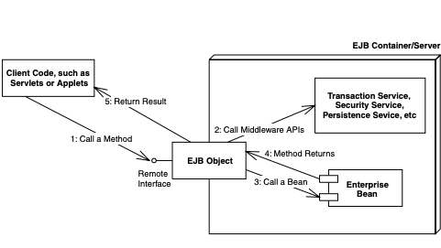
What Constitutes an Enterprise Bean?
The EJB Object
The EJB object is a surrogate object that knows about networking, transactions, security, and more. It is an intelligent object that knows how to perform intermediate logic that the EJB container requires before a method call is serviced by a bean class instance. An EJB object is the request interceptor, or the glue, between the client and the bean. EJB objects replicate and expose every business method that the bean itself exposes. EJB objects delegate all client requests to beans.
EJB objects

Slide 110
What Constitutes an Enterprise Bean?
The EJB Object
You should think of EJB objects as physical parts of the container; all EJB objects have container-specific code inside of them. (Each container handles middleware differently and provides different qualities of service.) Because each bean’s EJB object is different, your container vendor generates the class file for your EJB objects automatically.
Each EJB container ships with a suite of glue-code tools. These tools are meant to integrate beans into the EJB container’s environment. The tools generate helper Java code—stubs, skeletons, data access classes, and other classes that this specific container requires. Bean providers do not have to think about the specifics of how each EJB container works because the container’s tools generate its own proprietary Java code automatically.

Slide 111
What Constitutes an Enterprise Bean?
The EJB Container: Your Silent Partner
EJB containers are responsible for managing your beans. Containers can interact with your beans by calling your beans’ required management methods as necessary. These management methods are your beans’ callback methods that the container, and only the container, invokes. The management methods allow the container to alert your beans when middleware events take place, such as when an entity bean is about to be persisted to storage.
The key to understanding EJB containers is to realize that they are abstract entities. Neither the beans nor the clients that call beans ever explicitly code to the API of an EJB container. Rather, the container implicitly manages the overhead of a distributed component architecture. The container is analogous to a behind-the-scenes stage manager in a theatre, providing the lighting and backdrop necessary for a successful stage performance by the actors on stage. Neither the actors nor the audience interact directly with the stage manager. The same is true for EJB containers. Clients that call the beans never code directly to an EJB container API.

Slide 112
What Constitutes an Enterprise Bean?
The Remote Interface
As mentioned previously, bean clients invoke methods on EJB objects, rather than the beans themselves. Therefore, EJB objects must clone every business method that your bean classes expose. But how do the tools that autogenerate EJB objects know which methods to clone? The answer is in a special interface that a bean provider writes. This interface duplicates all the business logic methods that the corresponding bean class exposes. This interface is called the remote interface.
Remote interfaces must comply with special rules that the EJB specification defines. For example, all remote interfaces must derive from a common interface supplied by Sun Microsystems. This interface is called javax.ejb.EJBObject.

Slide 113
What Constitutes an Enterprise Bean?
The Remote Interface
public interface javax.ejb.EJBObject extends java.rmi.Remote {
public javax.ejb.EJBHome getEJBHome() throws java.rmi.RemoteException;
public java.lang.Object getPrimaryKey() throws java.rmi.RemoteException;
public void remove() throws java.rmi.RemoteException, javax.ejb.RemoveException;
public javax.ejb.Handle getHandle() throws java.rmi.RemoteException;
public boolean isIdentical(javax.ejb.EJBObject) throws java.rmi.RemoteException;
}

Slide 114
What Constitutes an Enterprise Bean?
The Remote Interface
javax.ejb.EJBObject lists a number of interesting methods. For now, don’t worry about fully understanding the meanings—just know that these are required methods that all EJB objects must implement. And remember that you don’t implement the methods—the EJB container does when it autogenerates the EJB objects for you.
The client code that wants to work with your beans calls the methods in javax.ejb.EJBObject. This client code could be stand-alone applications, applets, servlets, or anything at all—even other enterprise beans.

Slide 115
What Constitutes an Enterprise Bean?
The Instance-Pooling Concept
A multi-tier architecture’s overall scalability is enhanced when an application server intelligently manages needed resources across a variety of deployed components. The resources could be threads, socket connections, database connections, and more. For example, database connections could be pooled by application servers and reused across heterogeneous components. In the EJB realm, the container is responsible for providing all resource management services behind the scenes.

Slide 116
What Constitutes an Enterprise Bean?
The Instance-Pooling Concept
In addition to resource management, the EJB container is responsible for controlling the life cycle of the deployed enterprise bean components. As bean client requests arrive, the EJB container dynamically instantiates, destroys, and reuses beans as appropriate. For example, if a client requests a certain type of bean that does not yet exist in memory, the EJB container may instantiate a new in-memory instance on behalf of the client. On the other hand, if a bean already exists in memory, it may not be appropriate to instantiate a new bean, especially if the system is low on memory. It might make more sense to reassign a bean from one client to another instead. It might also make sense to destroy some beans that are not being used anymore. This is called instance pooling.

Slide 117
What Constitutes an Enterprise Bean?
Java RMI-IIOP and EJB Objects
You may have noticed that javax.ejb.EJBObject extends java.rmi.Remote. The java.rmi.Remote interface is part of Java Remote Method Invocation over the Internet Inter-ORB Protocol (RMI-IIOP). Any object that implements java.rmi.Remote is a remote object and is callable from a different Java Virtual Machine. This is how remote method invocations are performed in Java.
Because the EJB object provided by the container implements your remote interface, it also indirectly implements java.rmi.Remote. Your EJB objects are fully networked RMI-IIOP objects, able to be called from other Java Virtual Machines or physical machines located elsewhere on the network. Thus, EJB remote interfaces are really just RMI-IIOP remote interfaces—except that EJB remote interfaces must also be built to conform to the EJB specification.

Slide 118
What Constitutes an Enterprise Bean?
Java RMI-IIOP and EJB Objects
EJB remote interfaces must conform to RMI-IIOP’s remote interface rules. For example, any method that is part of a remote object callable across virtual machines must throw a special remote exception. A remote exception is a java.rmi.RemoteException, or (technically) a subclass of it. A remote exception indicates that something unexpected happened on the network while you were invoking across virtual machines, such as a network, process, or machine failure. Every method shown in Source for javax.ejb.EJBObject throws a java.rmi.RemoteException.

Slide 119
What Constitutes an Enterprise Bean?
The Home Object
As we’ve seen, client code deals with EJB objects and never with beans directly. The next logical question is, how do clients acquire references to EJB objects?
To acquire a reference to an EJB object, your client code asks for an EJB object from an EJB object factory. This factory is responsible for instantiating (and destroying) EJB objects. The EJB specification calls such a factory a home object. The chief responsibilities of home objects are the following:
■■ Create EJB objects
■■ Find existing EJB objects (for entity beans)
■■ Remove EJB objects

Slide 120
What Constitutes an Enterprise Bean?
Location Transparency
EJB inherits a significant benefit from RMI-IIOP. In RMI-IIOP, the physical location of the remote object you’re invoking on is masked from you. This feature spills over to EJB. Your client code is unaware of whether the EJB object it is using is located on a machine next door or a machine across the Internet. It also means the EJB object could be located on the same Java VM as the client. This is called location transparency.

Slide 121
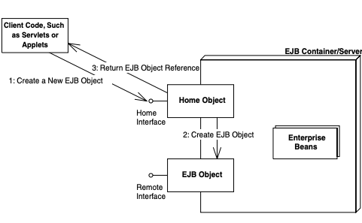
What Constitutes an Enterprise Bean?
The Home Interface
We’ve seen that home objects are factories for EJB objects. But how does a home object know how you’d like your EJB object to be initialized? For example, one EJB object might expose an initialization method that takes an integer as a parameter, and another EJB object might take a string instead. The container needs to know this information to generate home objects. You provide this information to the container by specifying a home interface. Home interfaces simply define methods for creating, destroying, and finding EJB objects. The container’s home object implements your home interface. We show this in Figure.
Home interfaces and objects

Slide 122
What Constitutes an Enterprise Bean?
The Home Interface
As usual, EJB defines some required methods that all home interfaces must support. These required methods are defined in the javax.ejb.EJBHome interface—an interface that your home interfaces must extend.
public interface javax.ejb.EJBHome extends java.rmi.Remote {
public EJBMetaData getEJBMetaData() throws java.rmi.RemoteException;
public javax.ejb.HomeHandle getHomeHandle() throws java.rmi.RemoteException;
public void remove(javax.ejb.Handle handle) throws java.rmi.RemoteException, javax.ejb.RemoveException;
public void remove(Object primaryKey) throws java.rmi.RemoteException, javax.ejb.RemoveException;
}

Slide 123
What Constitutes an Enterprise Bean?
The Home Interface
Notice that the parent javax.ejb.EJBHome derives from java.rmi.Remote. This means your home interfaces do as well, implying that home objects are also fully networked Java RMI remote objects, which can be called across VMs. The types of parameters passed in the home interface’s methods must be valid types for Java RMI-IIOP.

Slide 124
What Constitutes an Enterprise Bean?
The Local Interfaces
One problem with the home interface is that creating beans through that interface is very slow. The same is true for calling beans through the remote interface. Just to give you an idea of what happens when you call an EJB object, the following steps may occur:
The client calls a local stub.
The stub marshals parameters into a form suitable for the network.
The stub goes over a network connection to the skeleton.
The skeleton demarshals parameters into a form suitable for Java.
The skeleton calls the EJB object.
The EJB object performs needed middleware, such as connection pooling, transactions, security, and lifecycle services.
Once the EJB object calls the enterprise bean instance, and the bean does its work, each of the preceding steps must be repeated for the return trip home.

Slide 125
What Constitutes an Enterprise Bean?
The Local Interfaces
New to EJB 2.0, you can now call enterprise beans in a fast, efficient way by calling them through their local objects rather than EJB objects. Local objects implement a local interface rather than a remote interface. The local objects are speed demons that allow you to make high-performance enterprise beans. The process works as follows:
The client calls a local object.
The local object performs needed middleware, such as connection pooling, transactions, security, and lifecycle services.
Once the enterprise bean instance does its work, it returns control to the local object, which then returns control to the client.

Slide 126
What Constitutes an Enterprise Bean?
The Local Interfaces
You can create beans in a fast way as well. Rather than using the home interface and home object, you can call a special local home interface, which is implemented by the container as the local home object.
These local interfaces are entirely optional; you can use them as a replacement or as a complement to the remote interfaces. For simplicity, we will use the word EJB object to mean the request interceptor, the remote interface to mean the interface to the request interceptor, the home object to mean the factory, and the home interface to mean the factory interface. Unless it’s pointed out explicitly, all information that applies to these remote interfaces and remote objects also apply to their local counterparts. Also note that the EJB specification has defined the term component interface to mean either the remote interface or local interface. We will occasionally use this term.

Slide 127
What Constitutes an Enterprise Bean?
The Local Interfaces
When you write a local interface, you extend javax.ejb.EJBLocalObject, and when you write a local home interface, you extend javax.ejb.EJBLocalHome. Those interfaces are previewed in the following code.
public interface javax.ejb.EJBLocalObject {
public javax.ejb.EJBLocalHome getEJBLocalHome() throws javax.ejb.EJBException;
public Object getPrimaryKey() throws javax.ejb.EJBException;
public boolean isIdentical(javax.ejb.EJBLocalObject) throws javax.ejb.EJBException;
public void remove() throws javax.ejb.RemoveException, javax.ejb.EJBException;
}
public interface javax.ejb.EJBLocalHome {
public void remove(java.lang.Object) throws javax.ejb.RemoveException, javax.ejb.EJBException;
}

Slide 128
What Constitutes an Enterprise Bean?
The Local Interfaces
Local interfaces have two important side effects:
They only work when you’re calling beans in the same process—for example, if you have a bank teller session bean that calls a bank account entity bean in the same application server. But there lies the rub. You cannot call a bean remotely if your code relies on the local interface. If you decide to switch between a local or remote call, you must change your code from using the local interface to using the remote interface. This is an inherent drawback to local interfaces.
They marshal parameters by reference rather than by value. While this may speed up your application because parameters are not copied, it also changes the semantics of your application. Be sure that you’re aware of this when coding your clients and beans.

Slide 129
What Constitutes an Enterprise Bean?
Relationship between Home Objects, EJB Objects, and Bean Instances
One question we frequently are asked in our EJB training courses is “How many home objects are there for each bean?” The answer to this question is vendor-specific. Most containers will have a 1:N relationship between home objects and bean instances. This means that all clients use the same home object instance to create EJB objects. The home object will probably be written to be thread-safe so that it can service many client requests concurrently. It is perfectly fine for the container to do this because the container itself is multithreaded (only your beans are single-threaded).

Slide 130
What Constitutes an Enterprise Bean?
Relationship between Home Objects, EJB Objects, and Bean Instances
Another question we typically get is “How many EJB object instances are there for each bean instance?” Some containers can have a 1:N relationship, where each EJB object is multithreaded (just like home objects). Other containers might have an M:N relationship, where M represents the number of EJB objects instantiated (and corresponds exactly to the number of clients currently connected), and N represents the number of bean instances in the pool. In this case, each EJB object is single-threaded.

Slide 131
What Constitutes an Enterprise Bean?
Deployment Descriptors
To inform the container about your middleware needs, you as a bean provider must declare your components’ middleware service requirements in a deployment descriptor file. For example, you can use a deployment descriptor to declare how the container should perform lifecycle management, persistence, transaction control, and security services. The container inspects the deployment descriptor to fulfill the requirements that you lay out. The deployment descriptor is the key to implicit middleware.

Slide 132
What Constitutes an Enterprise Bean?
Deployment Descriptors
Bean management and lifecycle requirements. These deployment descriptor settings indicate how the container should manage your beans. For example, you specify the name of the bean’s class, whether the bean is a session, entity, or message-driven bean, and the home interface that generates the beans.
Persistence requirements (entity beans only). Authors of entity beans use the deployment descriptors to inform the container about whether the bean handles its persistence on its own or delegates the persistence to the EJB container in which it’s deployed.
Transaction requirements. You can also specify transaction settings for beans in deployment descriptors. These settings specify the bean requirements for running in a transaction, such as a transaction must start whenever anyone calls this bean, and the transaction must end after my bean completes the method call.
Security requirements. Deployment descriptors contain access control entries, which the beans and container use to enforce access to certain operations. For example, you can specify who is allowed to use which beans, and even who is allowed to use each method on a particular bean. You can also specify what security roles the beans themselves should run in, which is useful if the beans need to perform secure operations. For example only bank executives can call the method to create new bank accounts.

Slide 133
What Constitutes an Enterprise Bean?
Deployment Descriptors
As a bean provider, you are responsible for creating a deployment descriptor. Once your bean is used, other parties can modify its deployment descriptor settings. For example, an application assembler who is piecing together an application from beans can tune your deployment descriptor. Similarly, a deployer who is installing your beans in a container in preparation for a deployment to go live can tune your deployment descriptor settings as well. This is all possible because deployment descriptors declare how your beans should use middleware, rather than you writing code that uses middleware. Declaring rather than programming enables people without Java knowledge and without source code access to tweak your components at a later time. This paradigm becomes an absolute necessity when purchasing EJB components from a third party because third-party source code is typically not available. By having a separate, customizable deployment descriptor, you can easily fine-tune components to a specific deployment environment without changing source code.

Slide 134
What Constitutes an Enterprise Bean?
Vendor-Specific Files
Since all EJB server vendors are different, they each have some proprietary value-added features. The EJB specification does not touch these features, such as how to configure load-balancing, clustering, monitoring, and so on. Therefore, each EJB server vendor may require that you include additional files specific to that vendor, such as XML files, text files, or binary files.

Slide 135
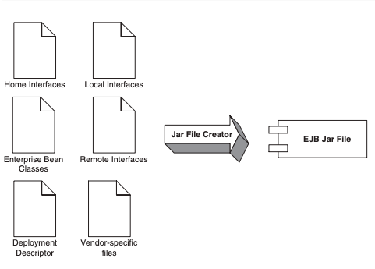
What Constitutes an Enterprise Bean?
Ejb-Jar File
Once you’ve generated your bean classes, your home interfaces, your remote interfaces, and your deployment descriptor, it’s time to package them into an Ejb-jar file. An Ejb-jar file is a compressed file that contains everything we have described, and it follows the .ZIP compression format. Jar files are convenient, compact modules for shipping your Java software. The Ejb-jar file creation process is shown in Figure.
Creating an Ejb-jar file

Slide 136
What Constitutes an Enterprise Bean?
Summary of Terms
For your convenience, we now list the definitions of each term we’ve described so far. As you read, refer to these definitions whenever you need clarification.
The enterprise bean instance is a Java object instance of an enterprise bean class. It contains business method implementations of the methods defined in the remote and/or local interface. The enterprise bean instance is network-less in that it contains no networked logic.
The remote interface is a Java interface that enumerates the business methods exposed by the enterprise bean class. In EJB, client code always goes through the remote interface and never interacts with the enterprise bean instance. The remote interface is network-aware in that the interface obeys the rules for Java RMI-IIOP.

Slide 137
What Constitutes an Enterprise Bean?
Summary of Terms
The local interface is the high-performing version of the remote interface. Use the local interface when you are calling enterprise beans that live in the same process. Your calls will not undergo stubs, skeletons, network calls, or marshaling/demarshaling of parameters.
The EJB object is the container-generated implementation of the remote interface. The EJB object is a network-aware intermediary between the client and the bean instance, handling necessary middleware issues. All client invocations go through the EJB object. The EJB object delegates calls to enterprise bean instances and implements the remote interface.
The local object is the high-performing version of the EJB object. The local object implements the local interface.

Slide 138
What Constitutes an Enterprise Bean?
Summary of Terms
The home interface is a Java interface that serves as a factory for EJB objects. Client code that wants to work with EJB objects must use the home interface to generate them. The home interface is network-aware because clients use it across the network.
The local home interface is the high-performing version of the home interface.
The home object is the container-generated implementation of the home interface. The home object is also network-aware, and it obeys RMI-IIOP’s rules.
The local home object is the high-performing version of the home object. The local home object implements the local home interface.

Slide 139
What Constitutes an Enterprise Bean?
Summary of Terms
The deployment descriptor is an XML file that specifies the middleware requirements of your bean. You use the deployment descriptor to inform the container about the implicit middleware you want, such as how to manage your bean, your bean’s lifecycle needs, your transactional needs, your persistence needs, and your security needs.
The vendor-specific files allow you to take advantage of vendor-specific features. These files are not portable between application servers.
The Ejb-jar file is the finished, complete .ZIP file that contains the above files. It is the unit of deployment and is given to the application server. The application server unpacks the Ejb-jar file and loads the bean.

Slide 140
Clean Code
Hints that the code you’re reading is a mess
Rigidity - No change is trivial, every change in the code add more twists and tangles.
Complexity - As above, no change is trivial and requires a lot of research.
Fragility - Changes breaking other parts of the code.
Immobility - You cannot reuse part of the existing code

Slide 141
Clean Code
General Rules
Follow the Boy Scout Rule : Leave the code cleaner than when you found it
Follow the Principle of Least Surprise

Slide 142
Clean Code
Principle of Least Astonishment
The principle of least astonishment (POLA), also called the principle of least surprise (alternatively a law or rule), applies to user interface and software design. The following is a typical statement of the principle: “If a necessary feature has a high astonishment factor, it may be necessary to redesign the feature.”.

